Slide 1


End to End Diabetes Prediction System
Major Project [1ET1020208]
B.Tech (CE) Sem-VIII
At
Department of Computer Engineering
Sankalchand Patel College of Engineering, Visnagar
Presented By
Name of student – (Krushil Modi) (Utkarsh Patel) (Nisarg Patel)
PRN No: (2021095900003707) (2021095900003681) (2021095900003603)
Guided By
Prof. Jayesh M Mevada

Slide 2
Outline
Project Title
Introduction
Motivation
Objective
Block Diagram
Machine Learning Workflow
Algorithms Used
Functionality of Project (Functional and non functional requirement)
Related/Similar projects Survey
References

Slide 3

Project Title
End to End Diabetes
Prediction System

Slide 4
Introduction about Project
Diabetes is a common chronic disease that can be dangerous.
Diabetes can be identified when blood glucose is higher than normal level, which is caused by high secretion of insulin or biological effects.
Diabetes can cause various damage to our body and can dysfunction kidneys, eyes and blood vessels.
Diabetes can be divided into two categories, type 1 diabetes and type 2 diabetes.
Patients with type 1 diabetes are normally younger with an age less then 30 years old. The clinical symptoms are increase thirst and frequent urination this type of diabetes cannot be cleared by medications as it requires therapy.
Type 2 diabetes occurs more commonly on middle-aged and old people, which can show hypertension, obesity and other diseases. with our living standards diabetes has increased commonly in people's daily life.

Slide 5
Motivation
The motivation was to experiment with end to end machine learning project.
Diabetes is an increasingly growing health issue due to our inactive lifestyle.
If it is detected in time then through proper medical treatment, adverse effects can be prevented.
To help in early detection, technology can be used very reliably and efficiently.
Using machine learning we have built a predictive model that can predict whether the patient is diabetes positive or not.".
This is also sort of fun to work on a project like this which could be beneficial for the society.

Slide 6
Objective
The main objective of a diabetes prediction system is to estimate an individual's risk of developing diabetes, typically type 2 diabetes. This can be done by analyzing various data points, including:
Demographics (age, gender, ethnicity)
Anthropometrics (body mass index, waist circumference)
Biochemical measurements (blood sugar, blood pressure, cholesterol)
Family history of diabetes
Lifestyle factors (diet, physical activity, smoking)

Slide 7
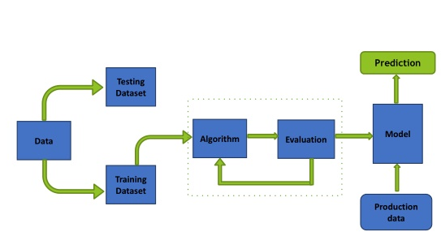
Block Diagram

Slide 8
Machine Learning Workflow
We can define the machine learning workflow in 5 stages.
Gathering data
Data pre-processing
Researching the model that will be best for the type of data
Training and testing the model
Evaluation

Slide 9
Algorithm - 1
The Random Forest Classifier:
Random Forest is a popular machine learning algorithm that belongs to the supervised learning technique. It is one of the widely used algorithms, which perform well with any kind of dataset, be it classification or regression.
It is based on the concept of ensemble learning, which is a process of combining multiple classifiers to solve a complex problem, and at the end, the results are either made an average of all the classifiers or mode of all the classifiers.
The greater number of trees in the forest leads to higher accuracy and prevents the problem of over fitting.

Slide 10
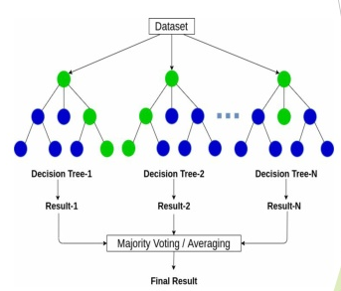
The Random Forest Classifier

Slide 11
Algorithm - 1
Decision Tree:
Decision tree, as the name suggests, creates a branch of nodes.
Where each internal node denotes a test on an attribute, each branch represents an outcome of the test, and the last nodes are termed as the leaf nodes.
Leaf node means there cannot be any nodes attached to them, and each leaf node (terminal node) holds a class label.
The decision tree is one of the most popular algorithms in machine learning, it can be sued for both classification and regression.
There are some exceptions to decision tree also, in terms of data scaling and data transformation, since decision tree works like a flowchart in the form of branches doing data transformation and scaling might be optional.

Slide 12
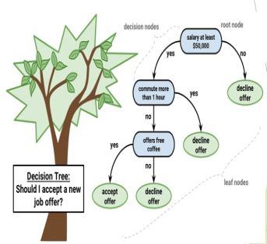
Decision Tree

Slide 13
Logistic Regression
Logistic Regression:
Logistic regression models a relationship between predictor variables and a categorical response variable.
Logistic regression helps us estimate a probability of falling into a certain level of the categorical response given a set of predictors.
We can choose from three types of logistic regression, depending on the nature of the categorical response variable.
Binary Logistic Regression:
Used when the response is binary (i.e., it has two possible outcomes).
Nominal Logistic Regression:
Used when there are three or more categories with no natural ordering to the levels.

Slide 14
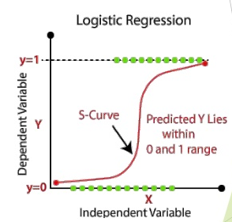
Logistic Regression

Slide 15
Functionality of Project (Functional and non-functional requirement)
Functionality:
Predictive ability: The core functionality is to accurately predict the risk of developing diabetes based on various input features like age, weight, blood sugar levels, etc.
Accuracy and reliability: The model should produce consistent and dependable predictions, minimizing false positives and negatives.
Scalability: The ability to handle large datasets efficiently is crucial for real-world applications with numerous patients.
2. Non-functionality:
Security and ethics: Training and deployment should adhere to data privacy regulations and ethical guidelines to avoid misuse.
Fairness and bias: The model should be unbiased and avoid discrimination against specific groups based on age, gender, or other factors.
Transparency and accountability: Clear documentation and explanation of the model's decision-making process are vital for building trust and understanding.

Slide 16
Related/Similar project Survey
Indian Diabetes Risk Score (IDRS):
The IDRS is a well-known scoring system for predicting the risk of diabetes. Some projects have implemented machine learning techniques to enhance and personalize predictions using features beyond those considered in traditional scoring systems.
Predicting Diabetes Using Electronic Health Records (EHR):
Researchers have explored using electronic health records for diabetes prediction. Machine learning models are trained on patient data, including clinical notes, lab results, and other relevant information.

Slide 17
References
Pima Indians Diabetes Database (Kaggle.com)
Diabetes Prediction using Machine Learning Algorithms – Science Direct
Predicting Diabetes Mellitus With Machine Learning Techniques – PMC (nih.gov)
Diabetes Prediction using Machine Learning Algorithms (researchgate.net)

